Slide 1
Presentation brief for MCT’s
Title of presentation | Enabling Team Based Data Science with Azure Databricks
Presentation\Lab length | Presentation: 40 - 45 minutes. Lab: 40 - 45 minutes.
Audience | Data Professionals, Data Architects, Business Intelligence Professionals, Developers.
Purpose | Understand the role Databricks has in helping business gain value out of data through data science and predictive analytics. Be able to provision a Databricks instance and be able to load and read data as well as perform basic transformations.
(think) Student key takeaways | The student should be able to think of examples of how Databricks could be used within their organization. The student should that they have some existing skills to read and transform data with either in SQL or Python.
(feel) Student desired mindset | The student should feel that is easy to set up a Databricks instance. The student should feel that they understand that they can use existing skills to work with Databricks.
(do) Student outcomes | The student should be able to provision a Databricks instance. The student should be to read data either using SQL or Python. The students should be able to perform basic transformations using either SQL or Python.
More information | For MCT course feedback, visit the Microsoft Official Courseware forum

Slide 2

DP-200T01: Enabling Team Based Data Science with Azure Databricks
Notes:
It is important to stress to the students that this module only focusses on the provisioning of Azure Databricks and notebooks to connect to data sources and perform data manipulation. This module will not go into the creation, training and scoring of models as this is work that is performed by a Data Scientist.

Slide 3
Agenda
L01 – Describe Azure Databricks
L02 - Provision Azure Databricks and Workspaces
L03 - Read Data using Azure Databricks
L04 - Perform transformations with Azure Databricks

Slide 4










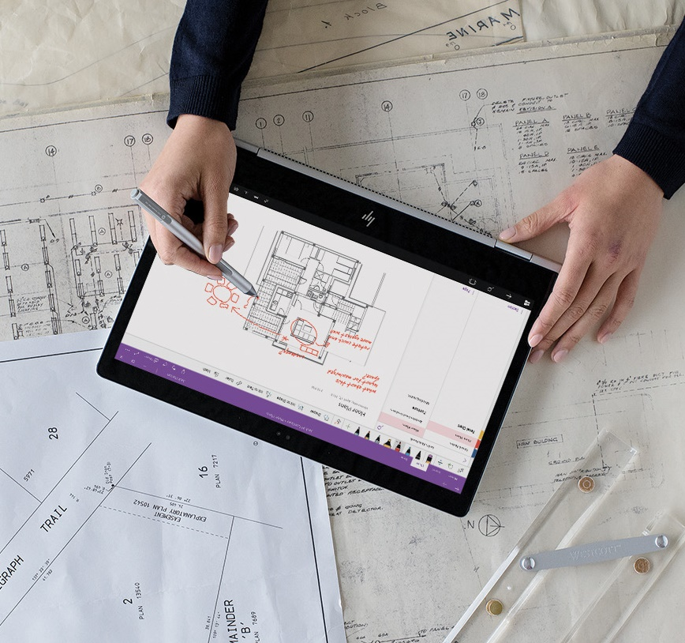


Lesson 01
Describe Azure Databricks
Data
Cloud
AI

Slide 5
Lesson Objectives
What is Azure Databricks
What are Spark based analytics platform
How Azure Databricks integrates with Enterprise Security
How Azure Databricks integrates with other Cloud Services

Slide 6

What is Azure Databricks
Apache
Spark-based
analytics
platform
Enterprise
Security
Integration
with other
Cloud Services
Simplifies the provisioning and collaboration of Apache Spark-based analytical solutions
Utilizes the security capabilities of Azure.
Can integrate with a variety of Azure data platform services and Power BI

Slide 7
What is Apache Spark
Apache Spark emerged to provide a parallel processing framework that supports in-memory processing to boost the performance of big-data analytical applications on massive volumes of data.
Why use Azure Databricks
Azure Databricks is a wrapper around Apache Spark that simplifies the provisioning and configuration of a Spark cluster in a GUI interface
.
Interactive Data Analysis
Used by business analysts or data engineers to analyze and prepare data.
Streaming Analytics
Ingest data from technologies such as Kafka and Flume to ingest data in real-time.
Machine Learning
Contains a number of libraries that enables a Data Scientist to perform Machine Learning.
Azure Databricks components.
Spark SQL and DataFrames
Streaming
Mlib
GraphX
Spark Core API

Slide 8

Enterprise Security
Azure Active Directory
Role Based Access Control
Enterprise Service Level Agreements
8

Slide 9
Integration with Cloud Services
Data Lake
Store
Cosmos DB
Data Factory
Power BI
SQL Data
Warehouse
Blob Store
Cognitive
Services

Slide 10
Review Questions
Q01 – Azure Databricks encapsulates which Apache Storage technology?
A01 – Apache Spark
Q02 - Which security features does Azure Databricks not support?
A02 – Shared Access Keys
Q03 - Which of the following Azure Databricks is used for support for R, SQL, Python, Scala, and Java?
A03 – Spark Core API

Slide 11
Lesson 02
Provision Azure Databricks
and Workspaces
Data
Cloud
AI

Slide 12
Lesson Objectives
Create your own Azure Databricks workspace
Create a cluster and notebook in Azure Databricks

Slide 13
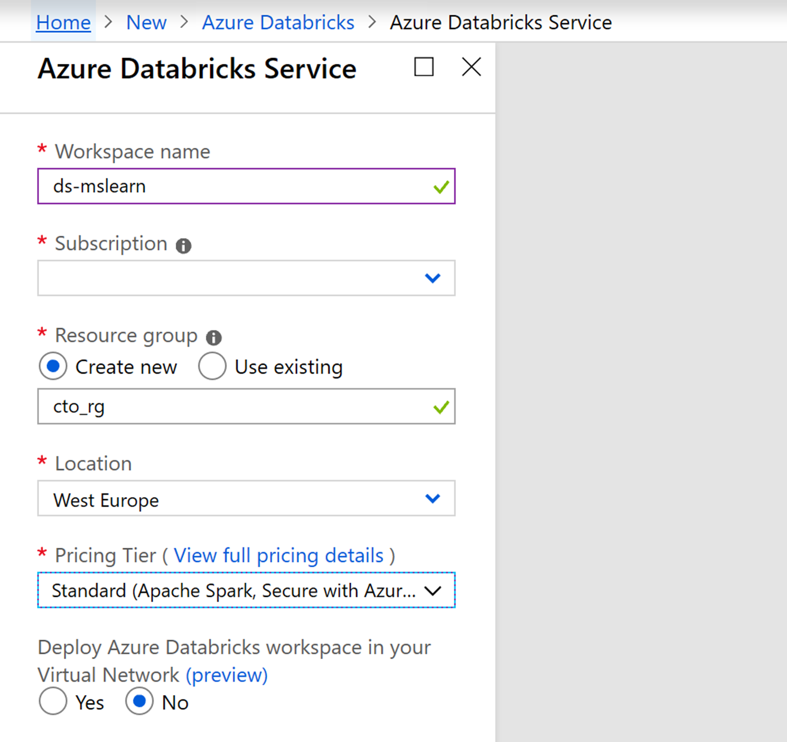
Create an Azure
Databricks Workspace.

Slide 14
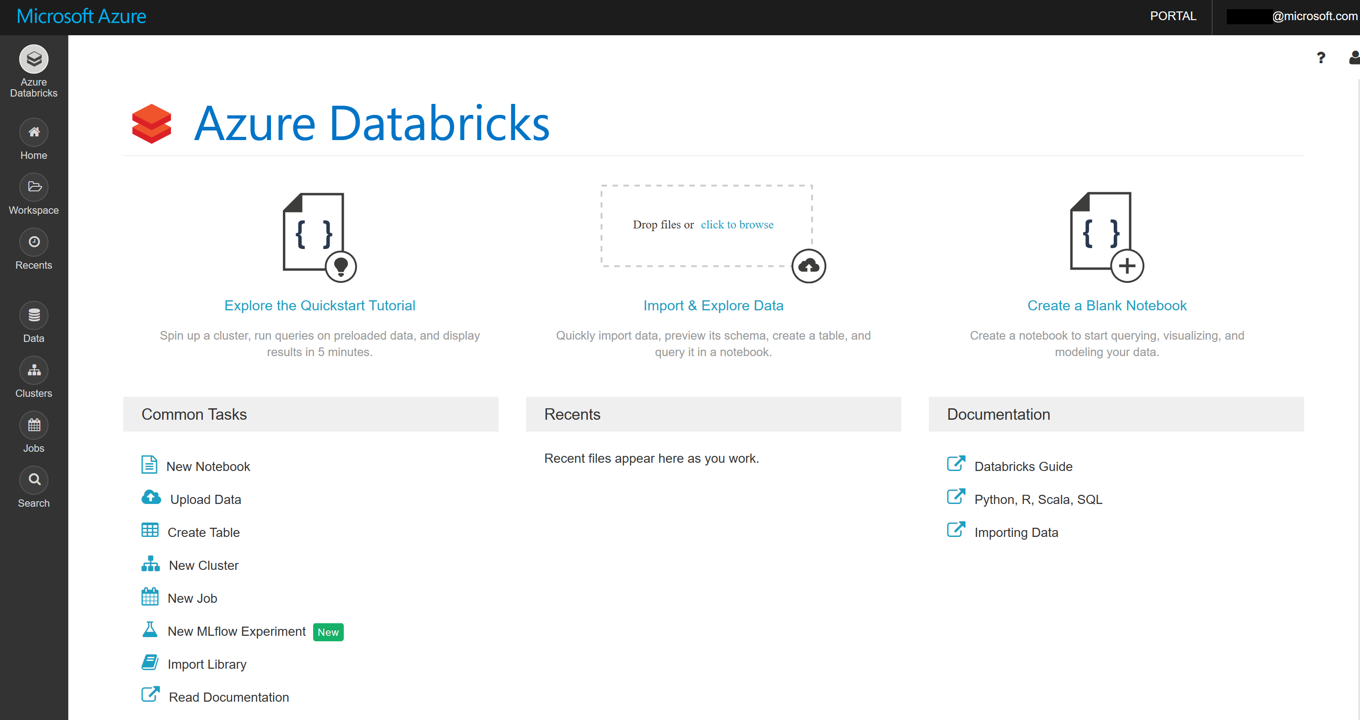
Create a Cluster and Notebook in Azure Databricks

Slide 15
Review Questions
Q01 - Which Notebook format is used in Databricks?
A01 – DBC
Q02 - Which browsers are recommended for best use with Databricks Notebook?
A02 – Chrome and Firefox

Slide 16
Lesson 03
Read Data
using Azure Databricks
Data
Cloud
AI

Slide 17
Lesson Objectives
Use Azure Databricks to access data sources
Reading Data in Azure Databricks

Slide 18
Data Lake
Cosmos DB
Use Azure Databricks to access data sources.
Event Hubs
SQL Database
SQL Data
Warehouse

Slide 19
SQL | DataFrame (Python)
SELECT col_1 FROM myTable | df.select(col("col_1"))
DESCRIBE myTable | df.printSchema()
SELECT * FROM myTable WHERE col_1 > 0 | df.filter(col("col_1") > 0)
..GROUP BY col_2 | ..groupBy(col("col_2"))
..ORDER BY col_2 | ..orderBy(col("col_2"))
..WHERE year(col_3) > 1990 | ..filter(year(col("col_3")) > 1990)
SELECT * FROM myTable LIMIT 10 | df.limit(10)
display(myTable) (text format) | df.show()
display(myTable) (html format) | display(df)
Reading Data in
Azure Databricks.

Slide 20
Review Questions
Q01 – How do you connect your Spark cluster to the Azure Blob?
A01 – By mounting it
Q02 - How does Spark connect to databases like MySQL, Hive and other data stores?
A02 – JDBC
Q03 - How do you specify parameters when reading data?
A03 – Using .option() during your read allows you to pass key/value pairs specifying aspects of your read

Slide 21
Lesson 04
Perform transformations
with Azure Databricks
Data
Cloud
AI

Slide 22
Lesson Objectives
Performing ETL to populate a data model
Perform basic transformations
Perform advanced transformations with user-defined functions

Slide 23
Performing ETL to populate a data model
The goal of transformation in Extract Transform Load (ETL) is to transform raw data to populate a data model.
Extraction
Data Validation
Transformation
Corrupt Record Handling
Loading Data
Connect to many data stores:
Postgres
SQL Server
Cassandra
Cosmos DB
CSV, Parquet
Many more..
Validate that the data is what you expect.
Applying structure and schema to your data to transform it into the desired format.
Built-in functions of Databricks allow you to handle corrupt data such as missing and incomplete information.
Highly effective design pattern involves loading structured data back to DBFS as a parquet file.

Slide 24
Normalizing Values
Missing/Null data
De-duplication
Pivoting Data frames
Basic transformation

Slide 25
Advanced Transformations
Advanced data transformation using custom and advanced user-defined functions, managing complex tables and loading data into multiple databases simultaneously.
User-defined functions
This fulfils scenarios when you need to define logic specific to your use case and when you need to encapsulate that solution for reuse. UDFs provide custom, generalizable code that you can apply to ETL workloads when Spark's built-in functions won't suffice.
Joins and lookup tables
A standard (or shuffle) join moves all the data on the cluster for each table to a given node on the cluster. This is an expensive operation. Broadcast joins remedy this situation when one DataFrame is sufficiently small enough to duplicate on each node of the cluster, avoiding the cost of shuffling a bigger DataFrame.
Multiple databases
Loading transformed data to multiple target databases can be a time-consuming activity. Partitions and slots are options to get optimum performance from database connections. A partition refers to the distribution of data while a slot refers to the distribution of computation.

Slide 26
Review Questions
Q01 – By default, how are corrupt records dealt with using spark.read.json()
A01 – They appear in a column called "_corrupt_record"
Q02 - What is the recommended storage format to use with Spark?
A02 – Apache Parquet

Slide 27

Lab: Enabling Team Based Data Science with Azure Databricks

Slide 28
Lab overview
In this lab, By the end of this lab the student will be able to explain why Azure Databricks can be used to help in Data Science projects. The students will provision and Azure Databricks instance and will then create a workspace that will be used to perform a simple data preparation task from a Data Lake Store Gen II store. Finally, the student will perform a walk-through of performing transformations using Azure Databricks.
Lab objectives
After completing this lab, you will be able to:
Explain Azure Databricks
Work with Azure Databricks
Read data with Azure Databricks
Perform transformations with Azure Databricks

Slide 29
Lab scenario
In response to the Information Services (IS) department, you will start the process of building a predictive analytics platform by listing out the benefits of using the technology. The department will be joined by data scientists and they want to ensure that there is a predictive analytics environment available to the new team members.
You will stand up and provision an Azure Databricks environment, and then test that this environment works by performing a simple data preparation routine on the service by ingesting data from a pre-existing Data Lake Storage Gen II account. As a data engineer, it has been indicated to you that you may be required to help the data scientists perform data preparation exercises. To that end you have been recommended to walk-through a notebook that can help you perform basic transformations.
At the end of this lad, you will have:
1. Explain Azure Databricks
2. Work with Azure Databricks
3. Read data with Azure Databricks
4. Perform transformations with Azure Databricks

Slide 30
Lab review
Exercise 1 – Why did you select the option to store the image files?
Exercise 2 – Apart from the Azure Portal, are there other methods to automate the deployment of storage accounts?
Exercise 3 – How is the storage structure of Data Lake Storage Gen II different to Storage Accounts?
Exercise 4 – Where in the Azure Portal would you find Microsoft Azure Storage Explorer?

Slide 31

Next steps
Module Summary
In this module, you have learned about:
- Azure Databricks
- How to provision Azure Databricks and Workspaces
- How to read Data using Azure Databricks
- How to perform transformations with Azure Databricks
After the course, consider watching this video with Yatharth Gupta that provides a deep dive into Azure Databricks deployment, networking and security.

